Slide 1

Centro Tecnológico Nacional Agroalimentario (CTAEX) - (Spain)
PROMOTIONAL PROFILE
RESEARCH GROUP:
CTAEX – Food Profile
Laura Moreno, Head of R&D Projects. Processes Department

Slide 2
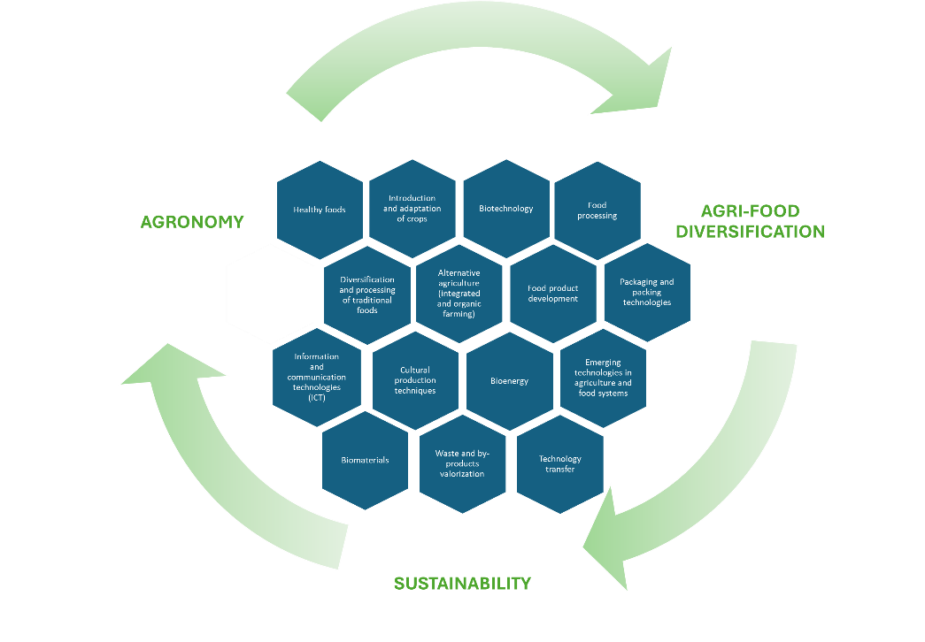
CTAEX (Spain)
CTAEX is a private non-profit R&D centre based in Extremadura, southwest Spain, founded in 2000 by a consortium of complementary agri-food entities. It addresses multiple scientific areas across the agri-food value chain, including sustainable agronomy, food production, biotechnology, and by-product management.
The Centre brings together 70 partners or associates belonging to the most representative agri-food sectors such as tomato, tobacco, wine, rice, olive, livestock, aromatic and medicinal plants, forestry, and natural ingredients, covering both primary and secondary processing as well as the valorisation of agri-food by-products
CTAEX’s research activity is focused on two specific technological pillars: agricultural and food research. Within these areas, the research lines defined as strategic are established, structured around three cross-cutting technological axes:
Sustainability, agri-food diversification, and information and communication technologies (ICT).
Figure 1.- CTAEX’s research lines

Slide 3
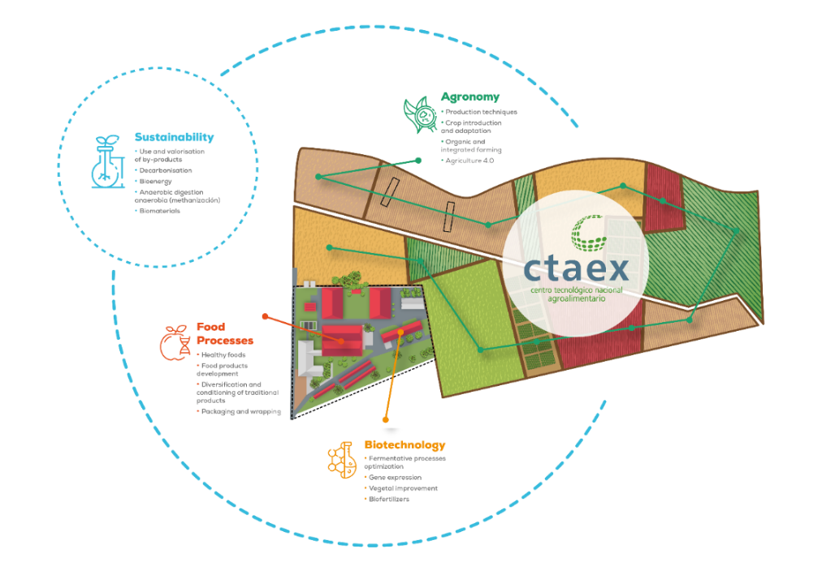
CTAEX (Spain)
CTAEX supports innovation and technology transfer from primary production to consumption to enhance sustainability, competitiveness and circularity.
CTAEX´s Agricultural Area has at its disposal green houses and 23 hectares of experimental farms (4 ha “ECO” certified among them) indicated for pot trials and large-scale cultivation and equipped with an irrigation general installation in total covering with a 1.000 m² storage pool and irrigation water supply wells. Besides CTAEX is authorized by the regional government to work with GMOs.
CTAEX has the authorization as a Producer of Seeds and Greenhouse Plants, with registry entry number ES/10/06/2574 as a Multiplier Producer for forest and ornamental species groups, horticultural plants, horticultural seeds, and as a Breeder-Selector Producer for textiles species groups (Cannabis sativa L.), as well as for the use of PEU Plant Passport.
Figure 2.- CTAEX’s areas

Slide 4

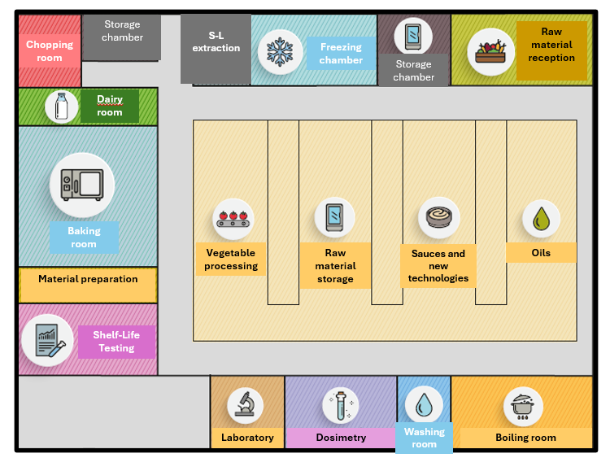
CTAEX (Spain)
In addition, CTAEX actively participates as an advisor in numerous trials conducted on external plots belonging to other cooperatives, and agricultural companies throughout the country to support farmers to transition to the incorporation of new crops or more sustainable agricultural practices in the European production systems by widely sharing practical knowledge and potentially deployed at large scale. Hereby enabling strong engagement and collaboration with other stakeholders across the agricultural value chain.
CTAEX´s Food Technology Area is equipped with both: facilities and machinery that make it possible to cover a great variety of industrial food products elaboration processes at laboratory and pilot scale (pilot plant and experimental kitchen).
The Centre focuses on the development of new food products and the adaptation of existing products to meet evolving market demands (semi-processed foods, ready meals, dairy, by-product valorisation and functional foods), with a strong emphasis on functional and healthy foods.
Figure 3.- CTAEX’s pilot plant and experimental kitchen

Slide 5
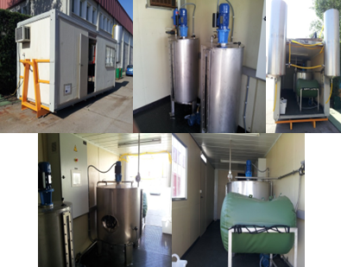
CTAEX (Spain)
In addition, CTAEX also provides comprehensive technical and sensory services to support industrial implementation, including sensory evaluation, shelf-life studies, ingredient assessment, formulation optimization, and sample production for market studies.
Special attention is given to consumer trends toward “superfoods” and products that are more natural, less processed, and lower in additives, contributing to sector diversification and supporting sustainable and innovative agri-food development.
In addition, CTAEX have four health registration numbers to manufacture, preparation, transformation and packaging of meat products, ready meals and sauces, condiment and spices and preserved vegetables, vegetables and pulses and extracts of products of vegetable.
CTAEX´s Process Area is integrated by the sustainability department, the analytical department and the transversal projects department. The Sustainability department carries out the technical advice on agri-food processes, optimisation of phases, by-products valorisation (extraction and recovery of active principles and interest compounds, use in animal feed or agriculture and energy production) and decarbonisation and promotion of bioenergy.
Figure 4.- S-L extraction pilot plant
Figure 5.- Biomethanization pilot plant

Slide 6

CTAEX (Spain)
CTAEX provides project results´ diffusion and dissemination through its certified Knowledge Transfer Office (KTO).
CTAEX has also launched several Technological Observatories (https://ctaex.com/observactaex), as platforms to transfer the latest technologies and research results in the field of R&D&I applicable to the agri-food sector.
The use of ICTs and digitalisation processes are the real drivers of development in agriculture and the food industry. The demonstration of 4.0 processes is one of the pillars of the centre, through the implementation of "farm-food-labs".
Figure 6.- Knowledge Transfer Office (KTO) services

Slide 7
HORIZON-CL6-2026-02-FARM2FORK-03
Boosting the competitiveness of protein crops in Europe
Expected Outcome/Scope/Other | Our contribution
The competitive production of protein crops is boosted across Europe, by developing and testing sustainable and cost-effective innovations tailored to different farming systems, regions and contexts. | By enabling innovations that enhance the competitiveness, resilience and sustainability of protein crops across diverse EU systems, with distinctive leadership in industrial hemp as a high-potential protein and multi-purpose crop with strong potential for food, feed and bioproduct markets, backed by more than 10 projects and over 12 years of consolidated experience in this value chain. CTAEX supports the deployment of new digital tools for precision protein‑crop management, in fact, is conducting collaborative initiatives such as the WE CANN project (national call), which applies blockchain‑based traceability, monitorization and carbon‑footprint assessment to industrial hemp cropping system further demonstrates its ability to bridge agronomic research, processing innovation and value‑chain adoption within diversified cropping systems and European sustainability protein‑autonomy strategies

Slide 8
HORIZON-CL6-2026-02-FARM2FORK-03
Boosting the competitiveness of protein crops in Europe
Expected Outcome/Scope/Other | Our contribution
Plant-based proteins production in Europe is increased, contributing to greater economical and environmental sustainability (including agrobiodiversity) and strengthening the European food and feed autonomy. | CTAEX conducts comprehensive physicochemical and nutritional profiling, soil and biomass characterizations, and protein quality analytics to support value-chain decision-making and compliance with food/feed safety and legality standards. CTAEX has practical experience in cross-border protein crop valorisation’s, notably participating in BGREENER and HEMPVALUE projects (Interreg Spain-Portugal), which promote hemp cultivation across diverse rural areas of Spain and Portugal, while enhancing biodiversity, improving soil quality while at the same time obtaining quality seeds and stalks for biobased value chains in bioconstruction and bioplastic applications.

Slide 9
HORIZON-CL6-2026-02-FARM2FORK-03
Boosting the competitiveness of protein crops in Europe
Expected Outcome/Scope/Other | Our contribution
Plant-based proteins production in Europe is increased, contributing to greater economical and environmental sustainability (including agrobiodiversity) and strengthening the European food and feed autonomy. | In addition, CTAEX characterizes the nutritional value of hemp seeds, along with their derivatives and by‑products, to assess their potential for high‑value food and feed applications, further supporting the development and valorisation of protein resources. This expertise is exemplified in the PORK‑MARLEY project (regional call), “Improving animal welfare through the use of hemp in the pig industry,” where hemp byproducts were incorporated into pig feed. It is also demonstrated in the HEMPVALUE project, where high‑protein organic beverages, sauces and ready‑to‑eat foods are being developed from hemp‑based ingredients

Slide 10
[End users]
Participation in almost all steps of the value chain of several primary sectors gives us an optimal positioning at the Centre of the quadruple helix model of the regional innovation system (science, policy, industry, and society), ensuring a multi-actor approach, bi-directional co-creation and knowledge exchange processes and between the actors in all the activities we carry out.
The Centre works actively with farmers and other value‑chain actors to ensure the effective adoption of sustainable practices and the integration of crops into local agricultural and industrial systems. It also leverages its multi‑actor partnerships and advisory networks to disseminate practical innovations and strengthens knowledge exchange through platforms such as the Hemp Hub, of which it is a cofounder, and EIHA (the European Industrial Hemp Association) of which it is a partner, reinforcing its role in supporting the development and consolidation of the value.
[Networks & Main Partners]
CTAEX belongs to several Platforms such as Technological Platform on vegetal Biotechnology (BIOVEGEN), Technological Platform Food for Life Spain (PTF4L Spain) and Bio-based Industries Consortium (BIC). Moreover, CTAEX is a founding partner of the Hemp Technology Pole. CTAEX is part of the 67 centres belonging to FEDIT (Spanish Federation of Technological Centres) and “Cooperativas Agro-alimentarias de España” (organisation that represents the agri-food cooperative movement before national and European bodies, institutions and associations related to the agri-food sector and the social economy).
CTAEX is recognized as a Cervera Excellence Centre in the priority area of Circular Economy, is member of the National PI+D+I Innovation Support Network.
The Center has been selected as an Advisor Support Service within the European AKIS Network.

Slide 11







Thank you
FOR YOUR ATTENTION
+34 639367092
lmoreno@ctaex.com
CTAEX
https://ctaex.com/

Slide 12
Contact details
OPE-SECTI Contact
Carlos Cabo Domínguez
CTAEX
OPE-SECTI
lmoreno@ctaex.com
carlos.cabo@fundecyt-pctex.es

