Slide 1

Centro Tecnológico Nacional Agroalimentario (CTAEX) - (Spain)
PROMOTIONAL PROFILE
RESEARCH GROUP:
CTAEX – Microbiome Profile
Laura Moreno, Head of R&D Projects. Processes Department

Slide 2
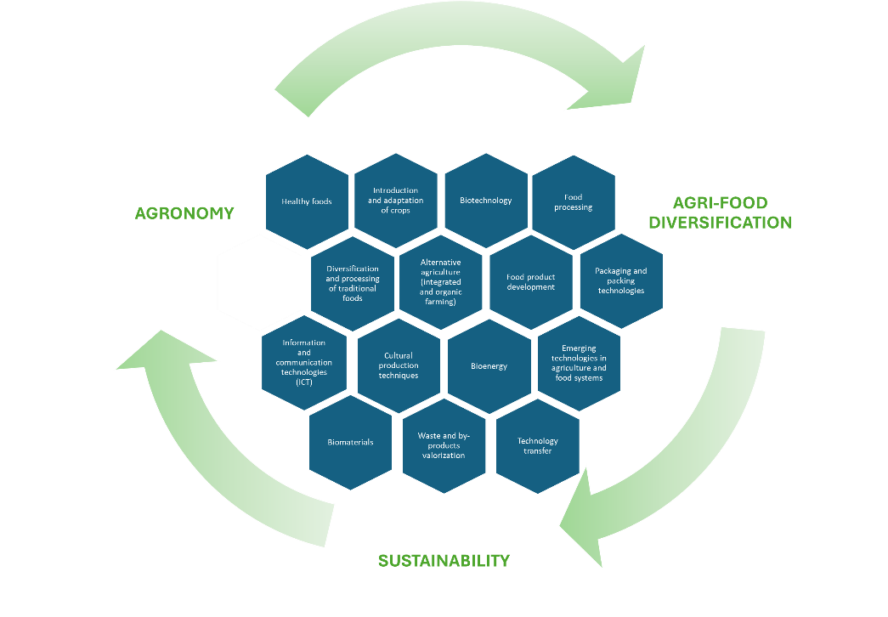
CTAEX (Spain)
CTAEX is a private non-profit R&D centre based in Extremadura, southwest Spain, founded in 2000 by a consortium of complementary agri-food entities. It addresses multiple scientific areas across the agri-food value chain, including sustainable agronomy, food production, biotechnology, and by-product management.
The Centre brings together 70 partners or associates belonging to the most representative agri-food sectors such as tomato, tobacco, wine, rice, olive, livestock, aromatic and medicinal plants, forestry, and natural ingredients, covering both primary and secondary processing as well as the valorisation of agri-food by-products
CTAEX’s research activity is focused on two specific technological pillars: agricultural and food research. Within these areas, the research lines defined as strategic are established, structured around three cross-cutting technological axes:
Sustainability, agri-food diversification, and information and communication technologies (ICT).
Figure 1.- CTAEX’s research lines

Slide 3
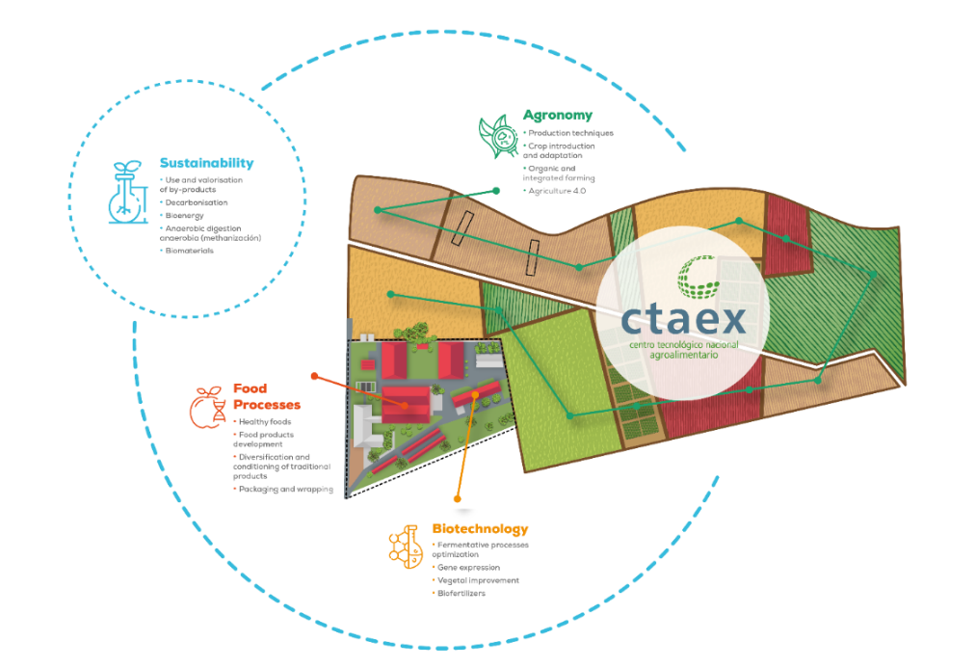
CTAEX (Spain)
CTAEX supports innovation and technology transfer from primary production to consumption to enhance sustainability, competitiveness and circularity.
CTAEX´s Agricultural Area supports sustainable and biodiversity-friendly agriculture through its extensive experimental infrastructure, which includes greenhouses and 23 hectares of experimental farms (4 hectares of which are ECO-certified) equipped for pot trials and large-scale cultivation with optimized irrigation systems. This capacity, together with regional authorization to work with GMOs and its official status as a registered producer of seeds and greenhouse plants, enables the testing and validation of environmentally friendly practices such as reduced use of plant-protection products, optimized fertilization and irrigation, improved soil management, and the evaluation of stress-tolerant crop varieties.
Figure 2.- CTAEX’s areas

Slide 4
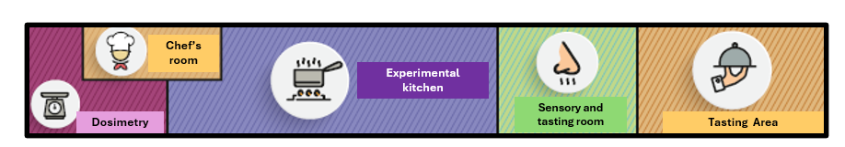
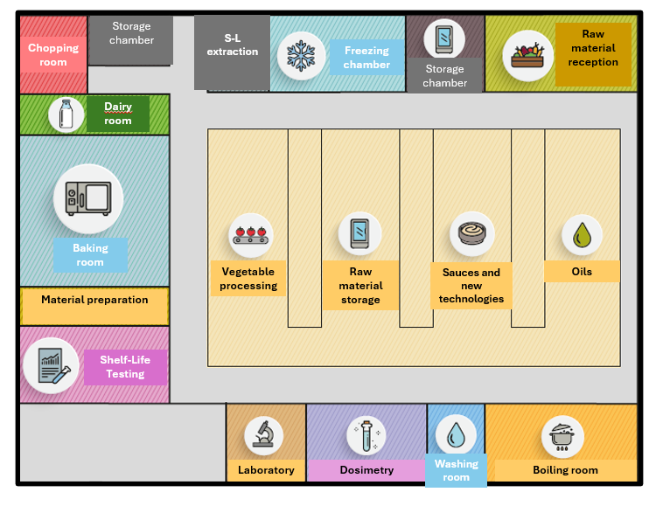
CTAEX (Spain)
In addition, CTAEX actively participates as an advisor in numerous trials conducted on external plots belonging to other cooperatives, and agricultural companies throughout the country to support farmers to transition to the incorporation of new crops or more sustainable agricultural practices in the European production systems by widely sharing practical knowledge and potentially deployed at large scale. Hereby enabling strong engagement and collaboration with other stakeholders across the agricultural value chain.
CTAEX´s Food Technology Area is equipped with advanced laboratory and pilot-scale facilities, including a pilot plant and experimental kitchen, enabling the development, reformulation, and validation of a wide range of food products in line with market and consumer demands, with a strong focus on functional, healthy, and minimally processed foods.
The Centre applies advanced processing and preservation technologies, provides technical, sensory, and consultancy services to support industrial implementation, and holds official health registrations that allow applied research and pilot trials under industry-equivalent conditions, ensuring that resulting products are legally compliant, scalable, and directly transferable to the agri-food industry.
Figure 3.- CTAEX’s pilot plant and experimental kitchen

Slide 5
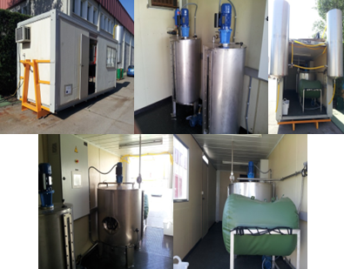
CTAEX (Spain)
CTAEX´s Process Area is integrated by the sustainability department, the analytical department and the transversal projects department.
The Sustainability department carries out the technical advice on agri-food processes, optimisation of phases, by-products valorisation (extraction and recovery of active principles and interest compounds, use in animal feed or agriculture and energy production) and decarbonisation and promotion of bioenergy.
The Analytical department carries out analysis for the agri-food sector of the area. Apart from the external companies´ agri-food matrices analysis, this Dept. addresses R&D lines related to the extraction, isolation and stabilization of chemical interesting compounds found in agricultural and food residues and by-products. This department is highly specialized in agri-food kind of matrixes. The Laboratory is accredited by ENAC in the UNE-EN ISO/IEC 17025:2017 standard with accreditation number 1467/LE2629 for medicinal cannabis and industrial hemp testing.
Figure 4.- S-L extraction pilot plant
Figure 5.- Biomethanization pilot plant

Slide 6
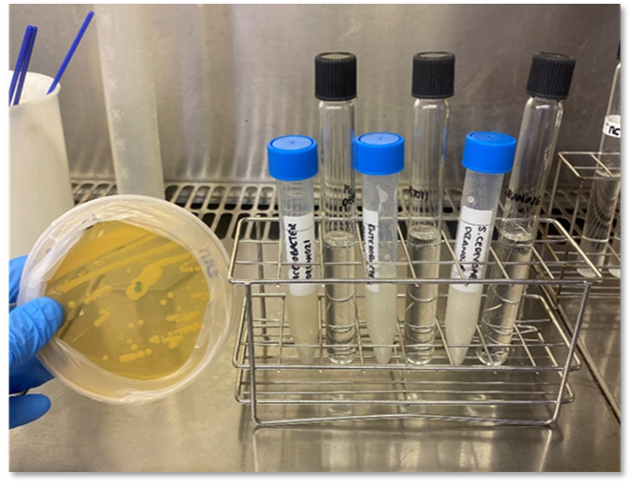
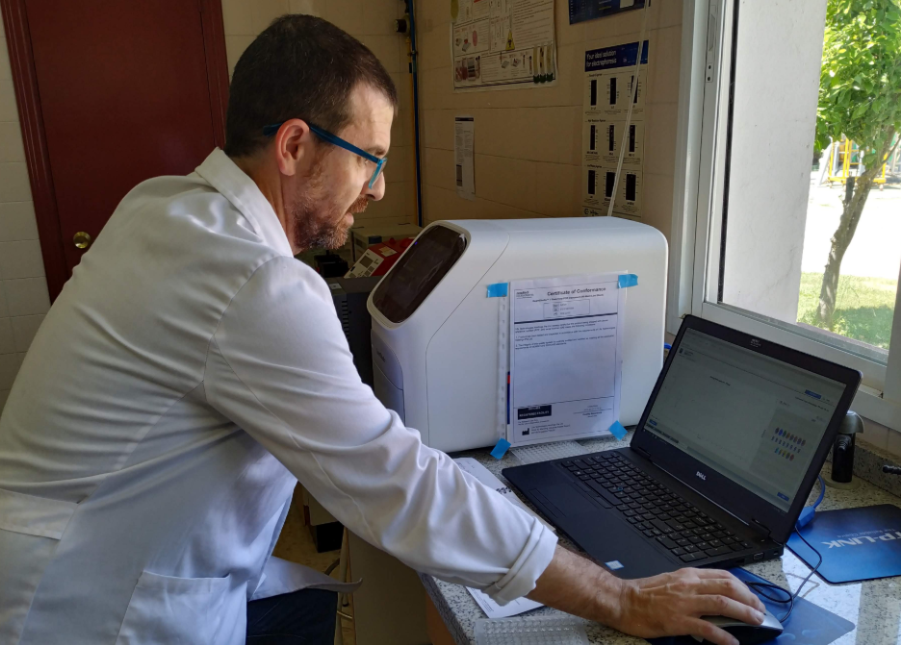
CTAEX (Spain)
The Biotechnology department is equipped with specialist laboratory facilities and applied expertise for the development, optimisation and validation of microbiological and biotechnological solutions aimed at supporting the transition towards more sustainable, resilient and biodiversity-friendly agri-food systems.
The Biotechnology area focuses on the design, characterisation and optimisation of functional microbial consortia and microbe-plant interaction strategies, contributing to the expansion of non-chemical and preventive approaches within integrated management frameworks. The department has proven experience in working with microorganisms relevant to agriculture, including the evaluation of their functional traits related to nutrient mobilisation, stress mitigation and plant performance under real agronomic conditions.
In addition, the Biotechnology area provides expertise in the assessment of soil-plant-microbiome interactions, supporting data-driven monitoring and the evaluation of biological solutions under different environmental and management scenarios.
Figure 7.- CTAEX’s Biotechnology department

Slide 7

CTAEX (Spain)
Through its applied research and demonstration capacity, CTAEX ensures that developed biotechnological solutions are technically robust, scalable and directly transferable to real farming context, fully aligned with Farm to Fork priorities on sustainability, integrated management and long-term system resilience
CTAEX provides project results´ diffusion and dissemination through its certified Knowledge Transfer Office (KTO).
CTAEX has also launched several Technological Observatories (https://ctaex.com/observactaex), as platforms to transfer the latest technologies and research results in the field of R&D&I applicable to the agri-food sector.
The use of ICTs and digitalisation processes are the real drivers of development in agriculture and the food industry. The demonstration of 4.0 processes is one of the pillars of the centre, through the implementation of "farm-food-labs".
Figure 7.- Knowledge Transfer Office (KTO) services

Slide 8
HORIZON-CL6-2026-02-FARM2FORK-11
Integrating a holistic perspective in microbiome research for resilient, competitive and sustainable food systems
Expected Outcome/Scope/Other | Our contribution
A better systems-level understanding through a One Health approach of the complex interactions and functional impacts of microbiomes across different hosts (plants, humans, animals...), environments (water, food matrices...), and interconnected ecosystemsM. | CTAEX has stablished research capacities based on holistic systems perspective to study microbiomes and their interactions with hosts and environments, with a strong focus on agri-food systems durability, resilience and sustainability. Its activities address microbiomes associated with plants, food matrices and agri-food environments, supporting systems-level understanding of the functional impacts of microbiomes across interconnected ecosystems, in line with a One Health approach. CTAEX actively investigates microbiome structure and function using targeted molecular approaches, supporting integrated microbiome studies through the identification, monitoring and functional assessment of key microbial groups and genes. In particular, CTAEX has solid experience in PCR-based techniques and gene expression analyses to study microbiome-host and microbiome-environment interactions, contributing to the understanding of functional impacts of microbiomes within agri-food systems, especially in relation to food safety, primary production and food matrices

Slide 9
HORIZON-CL6-2026-02-FARM2FORK-11
Integrating a holistic perspective in microbiome research for resilient, competitive and sustainable food systems
Expected Outcome/Scope/Other | Our contribution
A better systems-level understanding through a One Health approach of the complex interactions and functional impacts of microbiomes across different hosts (plants, humans, animals...), environments (water, food matrices...), and interconnected ecosystemsM. | CTAEX actively investigates microbiome structure and function using targeted molecular approaches, supporting integrated microbiome studies through the identification, monitoring and functional assessment of key microbial groups and genes. In particular, CTAEX has solid experience in PCR-based techniques and gene expression analyses to study microbiome-host and microbiome-environment interactions, contributing to the understanding of functional impacts of microbiomes within agri-food systems, especially in relation to food safety, primary production and food matrices

Slide 10
HORIZON-CL6-2026-02-FARM2FORK-11
Integrating a holistic perspective in microbiome research for resilient, competitive and sustainable food systems
Expected Outcome/Scope/Other | Our contribution
Synergies are identified between existing European research infrastructures for sample biobanking and data-gathering/gathering/sharing to facilitate the exchange, pooling and integrated analysis of integrated microbiome (meta)-data, promoting inter and transdisciplinary collaboration among different stakeholders under the FAIR (Findable, Accessible, Interoperable and Re-usable) principles | CTAEX also has experience in providing reference strains and well-characterized samples, together with standard protocols, operating procedures and quality control measures, supporting biobanking and data-repository activities that facilitate further microbiome studies and cross-project interoperability. These capacities support the development of shared resources for food safety, holobiont selection and sustainable biomanufacturing applications.

Slide 11
HORIZON-CL6-2026-02-FARM2FORK-11
Integrating a holistic perspective in microbiome research for resilient, competitive and sustainable food systems
Additional contribution
All this experience is demonstrated by participation in projects such as NEOBIOFERT (national call) about the isolation and identification of native bacterial strains for the development of specific biofertilizers for industrial tomato drop; FermentaVeg_4GUT (national call) to development and optimisation of controlled fermentation processes for fresh and creamed vegetable matrices aimed at generating functional ingredients and food products with immunomodulatory effects, mediated by specific modulation of the intestinal environment and gut microbiota composition and activity; BIOFERCANN (national call), to research and development of biofertilizer bacteria for cannabis cultivation or NEWCOTIANA (H2020-NMBP-BIO-2017 – DOI 10.3030/760331) to developing multipurpose nicotiana crops for molecular farming using new plant breeding techniques.

Slide 12
[End users]
The Centre works actively with farmers and other value‑chain actors to ensure the effective adoption of sustainable practices and the integration of crops into local agricultural and industrial systems. It also leverages its multi‑actor partnerships and advisory networks to disseminate practical innovations and strengthens knowledge exchange through platforms such as the Hemp Hub, of which it is a cofounder, and EIHA (the European Industrial Hemp Association) of which it is a partner, reinforcing its role in supporting the development and consolidation of the value.
[Networks & Main Partners]
CTAEX belongs to several Platforms such as Technological Platform on vegetal Biotechnology (BIOVEGEN), Technological Platform Food for Life Spain (PTF4L Spain) and Bio-based Industries Consortium (BIC). Moreover, CTAEX is a founding partner of the Hemp Technology Pole. CTAEX is part of the 67 centres belonging to FEDIT (Spanish Federation of Technological Centres) and “Cooperativas Agro-alimentarias de España” (organisation that represents the agri-food cooperative movement before national and European bodies, institutions and associations related to the agri-food sector and the social economy).
CTAEX is recognized as a Cervera Excellence Centre in the priority area of Circular Economy, is member of the National PI+D+I Innovation Support Network.
The Center has been selected as an Advisor Support Service within the European AKIS Network.

Slide 13







Thank you
FOR YOUR ATTENTION
+34 639367092
lmoreno@ctaex.com
CTAEX
https://ctaex.com/

Slide 14
Contact details
OPE-SECTI Contact
Carlos Cabo Domínguez
CTAEX
OPE-SECTI
lmoreno@ctaex.com
carlos.cabo@fundecyt-pctex.es

