Slide 1

Centro Tecnológico Nacional Agroalimentario (CTAEX) - (Spain)
PROMOTIONAL PROFILE
RESEARCH GROUP:
CTAEX – Plan Protection Profile
Laura Moreno, Head of R&D Projects. Processes Department

Slide 2
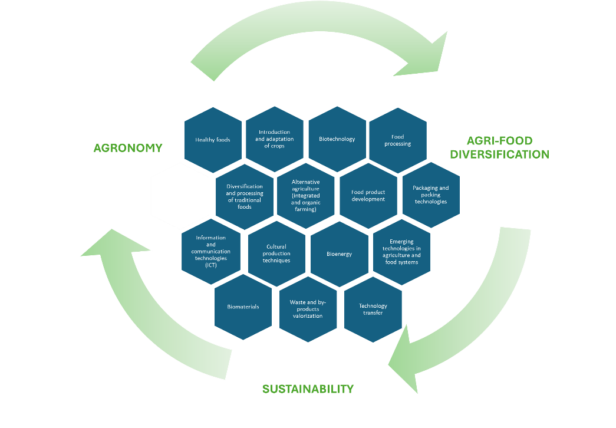
CTAEX (Spain)
CTAEX is a private non-profit R&D centre based in Extremadura, southwest Spain, founded in 2000 by a consortium of complementary agri-food entities. It addresses multiple scientific areas across the agri-food value chain, including sustainable agronomy, food production, biotechnology, and by-product management.
The Centre brings together 70 partners or associates belonging to the most representative agri-food sectors such as tomato, tobacco, wine, rice, olive, livestock, aromatic and medicinal plants, forestry, and natural ingredients, covering both primary and secondary processing as well as the valorisation of agri-food by-products
CTAEX’s research activity is focused on two specific technological pillars: agricultural and food research. Within these areas, the research lines defined as strategic are established, structured around three cross-cutting technological axes:
Sustainability, agri-food diversification, and information and communication technologies (ICT).
Figure 1.- CTAEX’s research lines

Slide 3
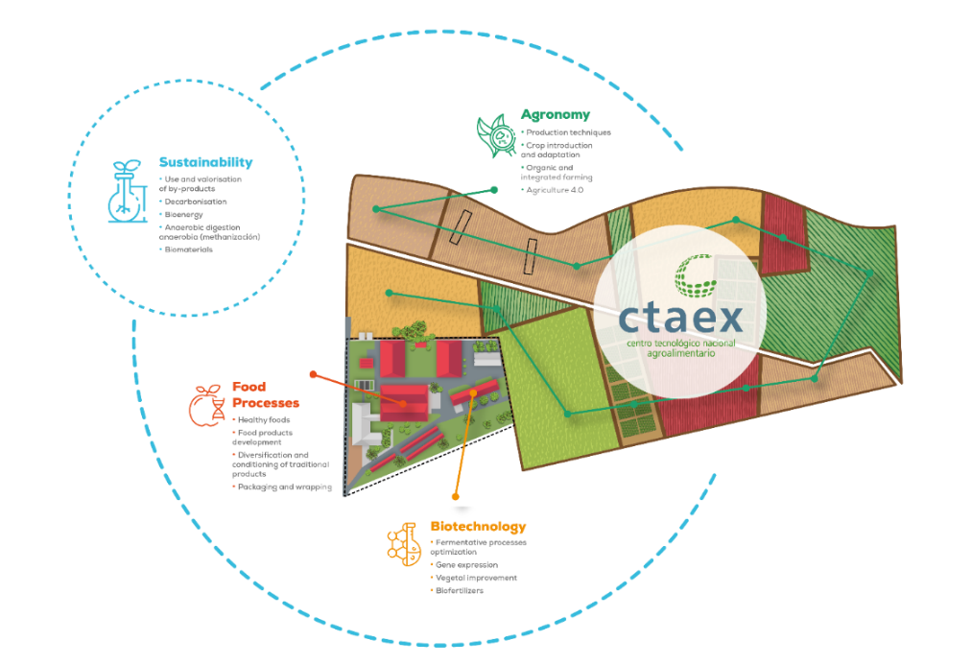
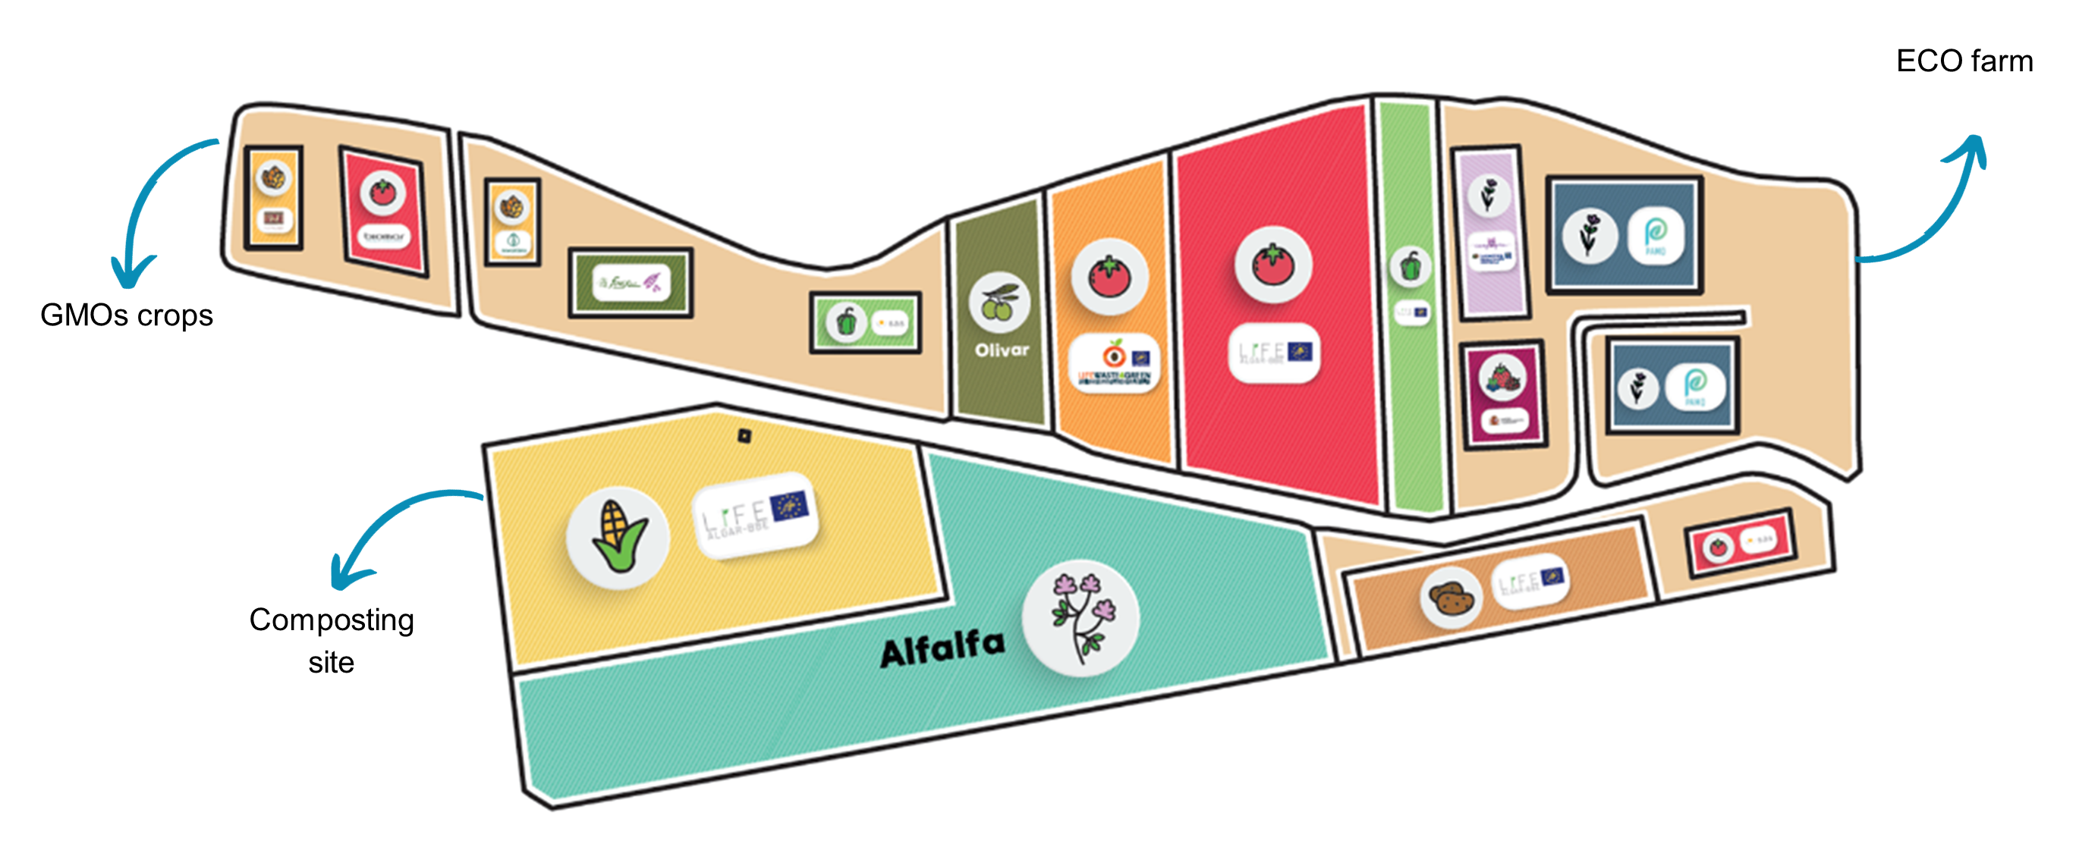
CTAEX (Spain)
CTAEX supports innovation and technology transfer from primary production to consumption to enhance sustainability, competitiveness and circularity.
CTAEX´s Agricultural Area has at its disposal green houses and 23 hectares of experimental farms (4 ha “ECO” certified among them) indicated for pot trials and large-scale cultivation and equipped with an irrigation general installation in total covering with a 1.000 m² storage pool and irrigation water supply wells. Besides CTAEX is authorized by the regional government to work with GMOs.
This infrastructure enables the implementation and evaluation of environmental‑friendly practices such as reducing the use of plant‑protection products, optimizing fertilization strategies and irrigation efficiency, improving soil management, and testing crop varieties with enhanced tolerance to multiple stresses.
Figure 2.- CTAEX’s areas
Figure 3.- CTAEX’s experimental farms

Slide 4

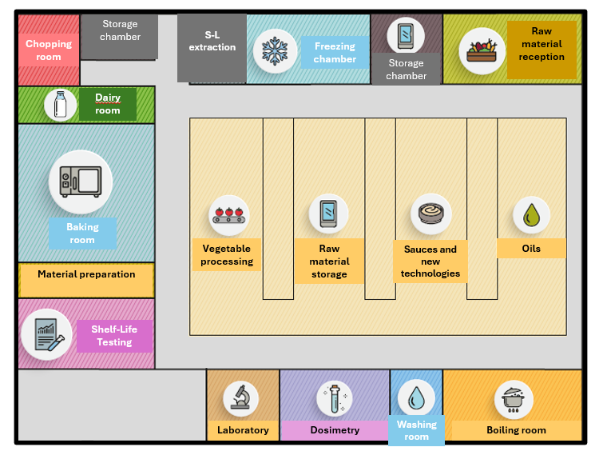
CTAEX (Spain)
CTAEX has the authorization as a Producer of Seeds and Greenhouse Plants, with registry entry number ES/10/06/2574 as a Multiplier Producer for forest and ornamental species groups, horticultural plants, horticultural seeds, and as a Breeder-Selector Producer for textiles species groups (Cannabis sativa L.), as well as for the use of PEU Plant Passport.
In addition, CTAEX actively participates as an advisor in numerous trials conducted on external plots belonging to other cooperatives, and agricultural companies throughout the country to support farmers to transition to the incorporation of new crops or more sustainable agricultural practices in the European production systems by widely sharing practical knowledge and potentially deployed at large scale. Hereby enabling strong engagement and collaboration with other stakeholders across the agricultural value chain.
CTAEX´s Food Technology Area is equipped with both: facilities and machinery that make it possible to cover a great variety of industrial food products elaboration processes at laboratory and pilot scale (pilot plant and experimental kitchen).
Figure 4.- CTAEX’s pilot plant and experimental kitchen

Slide 5
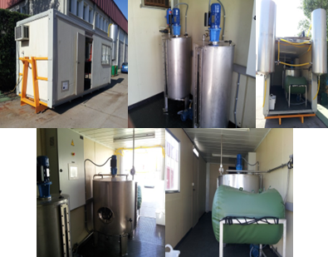
CTAEX (Spain)
CTAEX´s Process Area is integrated by the sustainability department, the analytical department and the transversal projects department.
The Sustainability department carries out the technical advice on agri-food processes, optimisation of phases, by-products valorisation (extraction and recovery of active principles and interest compounds, use in animal feed or agriculture and energy production) and decarbonisation and promotion of bioenergy.
The Analytical department carries out analysis for the agri-food sector of the area. Apart from the external companies´ agri-food matrices analysis, this Dept. addresses R&D lines related to the extraction, isolation and stabilization of chemical interesting compounds found in agricultural and food residues and by-products. This department is highly specialized in agri-food kind of matrixes. The Laboratory is accredited by ENAC in the UNE-EN ISO/IEC 17025:2017 standard with accreditation number 1467/LE2629 for medicinal cannabis and industrial hemp testing.
Figure 5.- S-L extraction pilot plant
Figure 6.- Biomethanization pilot plant

Slide 6
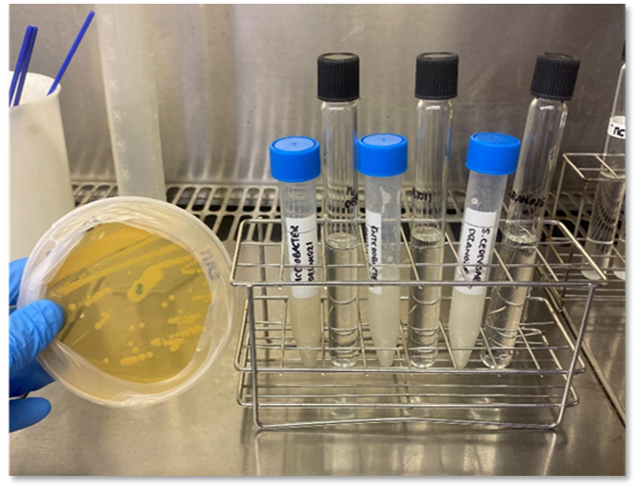
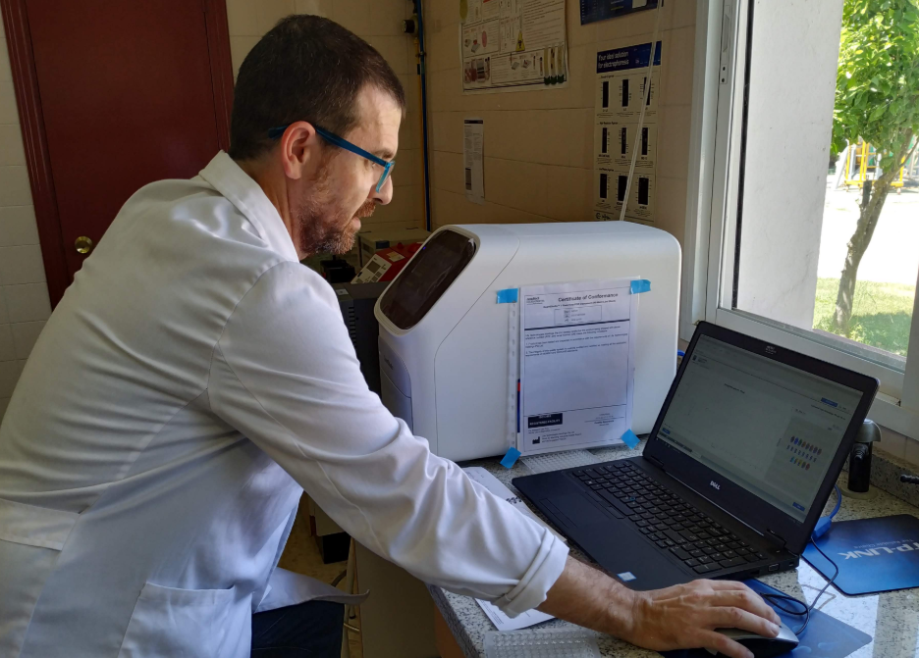
CTAEX (Spain)
The Biotechnology department is equipped with specialist laboratory facilities and applied expertise for the development, optimisation and validation of microbiological and biotechnological solutions aimed at supporting the transition towards more sustainable, resilient and biodiversity-friendly agri-food systems.
The Biotechnology area focuses on the design, characterisation and optimisation of functional microbial consortia and microbe-plant interaction strategies, contributing to the expansion of non-chemical and preventive approaches within integrated management frameworks. The department has proven experience in working with microorganisms relevant to agriculture, including the evaluation of their functional traits related to nutrient mobilisation, stress mitigation and plant performance under real agronomic conditions.
In addition, the Biotechnology area provides expertise in the assessment of soil-plant-microbiome interactions, supporting data-driven monitoring and the evaluation of biological solutions under different environmental and management scenarios.
Figure 7.- CTAEX’s Biotechnology department

Slide 7

CTAEX (Spain)
CTAEX provides project results´ diffusion and dissemination through its certified Knowledge Transfer Office (KTO).
CTAEX has also launched several Technological Observatories (https://ctaex.com/observactaex), as platforms to transfer the latest technologies and research results in the field of R&D&I applicable to the agri-food sector.
The use of ICTs and digitalisation processes are the real drivers of development in agriculture and the food industry. The demonstration of 4.0 processes is one of the pillars of the centre, through the implementation of "farm-food-labs".
Figure 8.- Knowledge Transfer Office (KTO) services

Slide 8
HORIZON-CL6-2026-02-FARM2FORK-02
Tackling pesticide resistance: early detection, management strategies, and foresight
Expected Outcome/Scope/Other | Our contribution
Map resistance risks by assessing the current and projected emergence of pest resistance, considering the declining number of available active substances and the authorised products for different crops | CTAEX can contribute a regional case study approach, using Extremadura as a representative use case for analysing pesticide use patterns and the emergence of resistance in typical production systems. This regional focus supports the mapping of resistance risks and the validation of microbiological alternatives under real-world conditions, enhancing the relevance and transferability of project results.

Slide 9
HORIZON-CL6-2026-02-FARM2FORK-02
Tackling pesticide resistance: early detection, management strategies, and foresight
Expected Outcome/Scope/Other | Our contribution
Develop early detection methods and predictive modelling (including AI-driven approaches) to anticipate and monitor the evolution of pesticide resistance, integrating advanced measurements tools and risk assessment methodologies, notably when products are used at farm level. | The centre applies targeted molecular and microbiological tools to support the early detection and monitoring of resistance-related risks, including the assessment of microbial and functional indicators linked to pesticide use and resistance development.

Slide 10
HORIZON-CL6-2026-02-FARM2FORK-02
Tackling pesticide resistance: early detection, management strategies, and foresight
Expected Outcome/Scope/Other | Our contribution
Design and evaluate innovative integrated pest and weed management (IPWM) strategies that reduce resistance risks by expanding non-chemical preventive and curative option. | CTAEX has established research and innovation capacities to contribute to tackling pesticide resistance through the development and validation of microbiological alternatives to chemical pesticides, supporting a holistic and science-based approach to crop protection. CTAEX actively develops and characterizes beneficial microbial strains and bacterial consortia with functional properties relevant for pest and disease suppression, plant health promotion and soil quality improvement. These microbiome-based solutions contribute to integrated pest and weed management (IPWM) strategies by expanding non-chemical preventive and curative options, directly addressing the need to reduce reliance on a shrinking portfolio of active substances.

Slide 11
HORIZON-CL6-2026-02-FARM2FORK-02
Tackling pesticide resistance: early detection, management strategies, and foresight
Additional contribution
CTAEX also contributes to capacity-building, stakeholder engagement and knowledge transfer, supporting the uptake of integrated, microbiome-based solutions by practitioners, advisors and other stakeholders, and facilitating the co-creation and validation of alternatives aligned with future regulatory and sustainability requirements.

Slide 12
HORIZON-CL6-2026-02-FARM2FORK-01
Developing innovative phytosanitary treatments for regulated plant pests to support safe international trade
Expected Outcome/Scope/Other | Our contribution
Innovative cost-effective environmental-friendly phytosanitary treatments for regulated plant pests with proven efficacy and practical applicability are developed and tested | CTAEX can contribute as a scientific and technical partner to the development and validation of innovative, cost-effective and environmentally friendly post-harvest phytosanitary treatments for fruits and vegetables, based on microbiological and biotechnological approaches, supporting safe international trade and compliance with EU plant health regulations. CTAEX has established expertise in the identification, characterisation and functional evaluation of microorganisms and microbial-derived compounds with antagonistic activity against regulated plant pests relevant to post-harvest stages. These microbiology-based solutions can be developed as novel phytosanitary treatments with proven efficacy, either as standalone approaches or a complementary measure within integrated post-harvest treatment systems

Slide 13
HORIZON-CL6-2026-02-FARM2FORK-01
Developing innovative phytosanitary treatments for regulated plant pests to support safe international trade
Expected Outcome/Scope/Other | Our contribution
Science-based guidelines and standardised protocols to support the consistent and efficient application of the developed treatments are available. | CTAEX supports the delivery of innovative microbiology-based phytosanitary treatments with clear protocols and strong potential for adoption by industry, regulatory authorities and third-party testing organisations, in line with EU plant health legislation and international trade requirements

Slide 14
HORIZON-CL6-2026-02-FARM2FORK-01
Developing innovative phytosanitary treatments for regulated plant pests to support safe international trade
Expected Outcome/Scope/Other | Our contribution
Enhanced capacity for implementation, including scalability and cost-effectiveness of treatment solutions and engagement of industry and trade actors, regulatory authorities, and third parties involved in testing and application | CTAEX brings expertise in biotechnological formulation and stabilisation of microbial agents or bioactive compounds, supporting the development of scalable and practically applicable post-harvest treatments

Slide 15
HORIZON-CL6-2026-01-ZEROPOLLUTION-02
Tackling pesticide resistance: early detection, management strategies, and foresight
Expected Outcome/Scope/Other | Our contribution
Innovative biotechnology and Nature-based Solutions (NbS) are developed and made available to communities, land managers, local administrators and policy makers in Ukraine to progress towards the targets of biodiversity protection and the clean environment and zero-pollution ambition | CTAEX can contribute as a scientific and technical partner to the development, optimisation, validation and demonstration of innovative biotechnology and Nature-based Solutions (NbS) for the bioremediation of conflict-contaminated soils, in line with the objectives of ecosystem restoration, zero pollution and the EU bioeconomy strategy. CTAEX brings strong knowledge in the design and optimization of microbiological consortia for soil bioremediation, as in heavy metal immobilization, biosorption, and bioaccumulation mechanisms. The centre can develop and fine-tune bacterial consortia integrating plant growth-promoting traits (PGPR), including siderophore production, ACC deaminase activity, phosphorus solubilization and biological nitrogen fixation, supporting both contaminant stabilization and ecosystem recovery.

Slide 16
HORIZON-CL6-2026-01-ZEROPOLLUTION-02
Developing innovative phytosanitary treatments for regulated plant pests to support safe international trade
Expected Outcome/Scope/Other | Our contribution
Contribution to the reconstruction, recovery, circularity and upgrading of economy and environment of Ukraine is provided through the remediation of severe ecosystems pollution - due to conflicts - and restoration of ecosystem services | These microbial consortia can be evaluated for their compatibility and performance in Chernozem-type soils, representative of large agricultural areas in Ukraine affected by war-related contamination. This allows the development of robust, cost-effective and adaptable microbial solutions tailored to the specific physicochemical conditions of conflict-impacted soils, directly addressing the topic´s requirement to adapt bioremediation techniques to extreme and poorly characterized contamination scenarios. CTAEX can contribute to the development of solid and liquid microbial inoculant prototypes, suitable for field demonstration, and support the assessment of remediation effectiveness through the evaluation of reductions in heavy metal bioavailability, soil phytotoxicity and plant stress indicators.

Slide 17
[End users]
Participation in almost all steps of the value chain of several primary sectors gives us an optimal positioning at the Centre of the quadruple helix model of the regional innovation system (science, policy, industry, and society), ensuring a multi-actor approach, bi-directional co-creation and knowledge exchange processes and between the actors in all the activities we carry out.
The Centre works actively with farmers and other value‑chain actors to ensure the effective adoption of sustainable practices and the integration of crops into local agricultural and industrial systems. It also leverages its multi‑actor partnerships and advisory networks to disseminate practical innovations and strengthens knowledge exchange through platforms such as the Hemp Hub, of which it is a cofounder, and EIHA (the European Industrial Hemp Association) of which it is a partner, reinforcing its role in supporting the development and consolidation of the value.
[Networks & Main Partners]
CTAEX belongs to several Platforms such as Technological Platform on vegetal Biotechnology (BIOVEGEN), Technological Platform Food for Life Spain (PTF4L Spain) and Bio-based Industries Consortium (BIC). Moreover, CTAEX is a founding partner of the Hemp Technology Pole. CTAEX is part of the 67 centres belonging to FEDIT (Spanish Federation of Technological Centres) and “Cooperativas Agro-alimentarias de España” (organisation that represents the agri-food cooperative movement before national and European bodies, institutions and associations related to the agri-food sector and the social economy).
CTAEX is recognized as a Cervera Excellence Centre in the priority area of Circular Economy, is member of the National PI+D+I Innovation Support Network.
The Center has been selected as an Advisor Support Service within the European AKIS Network.

Slide 18







Thank you
FOR YOUR ATTENTION
+34 639367092
lmoreno@ctaex.com
CTAEX
https://ctaex.com/

Slide 19
Contact details
OPE-SECTI Contact
Carlos Cabo Domínguez
CTAEX
OPE-SECTI
lmoreno@ctaex.com
carlos.cabo@fundecyt-pctex.es

