Slide 1


COLLABORATION OFFERS WITHIN WIDERA FUNDECYT SCIENCE AND TECHNOLOGY PARK OF EXTREMADURA
09/04/26

Slide 2
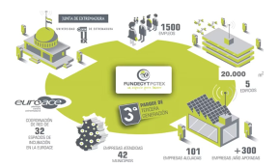
THE REGION OF EXTREMADURA
An moderate region in a strong innovation country
Sharing Research and Innovation Realities of Widening Countries
FUNDECYT is an innovation regonal facilitator and the host institution of CiiAE, the international center of research in Energy Storage

Slide 3
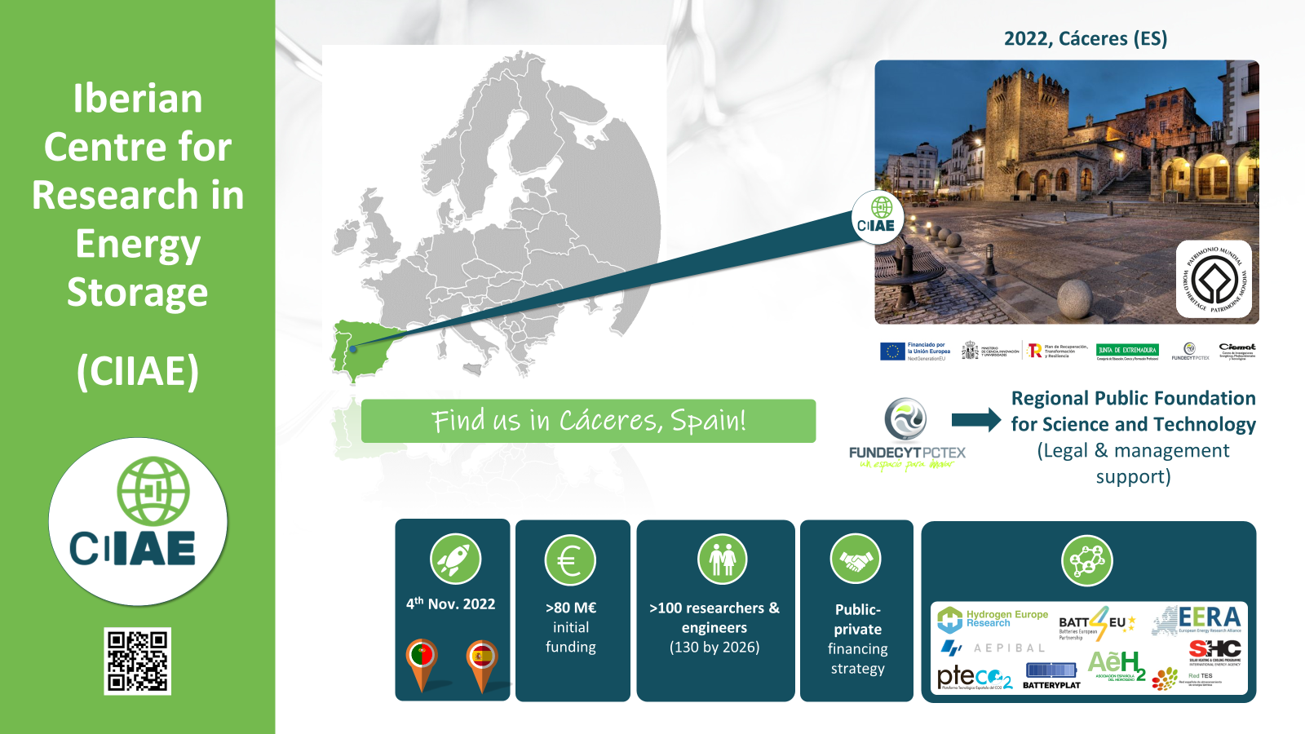
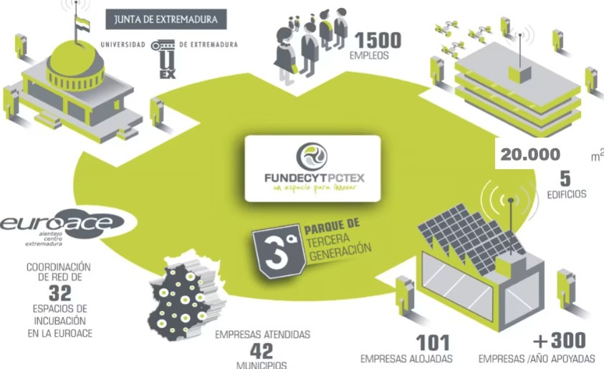
WHO WE ARE?
Our experience +50 Highly qualified professionals
+30 Years managing European projects (INTERREG, European Framework Programmes, Erasmus +, etc.)
Member of International Networks (EEN, 28Digital, EURADA, EURAXESS, IASP, etc.)
+100 Technology-based companies conducting R&D&I in our facilities

Slide 4
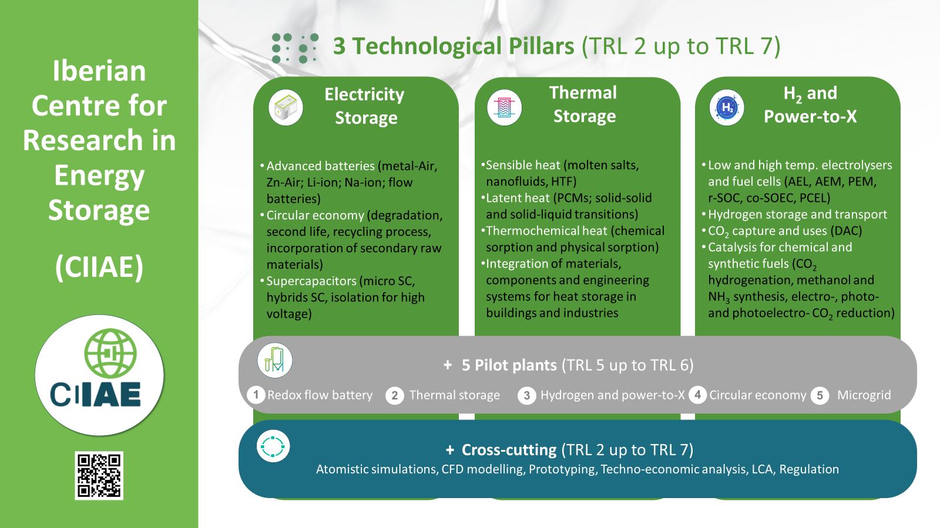

Slide 5
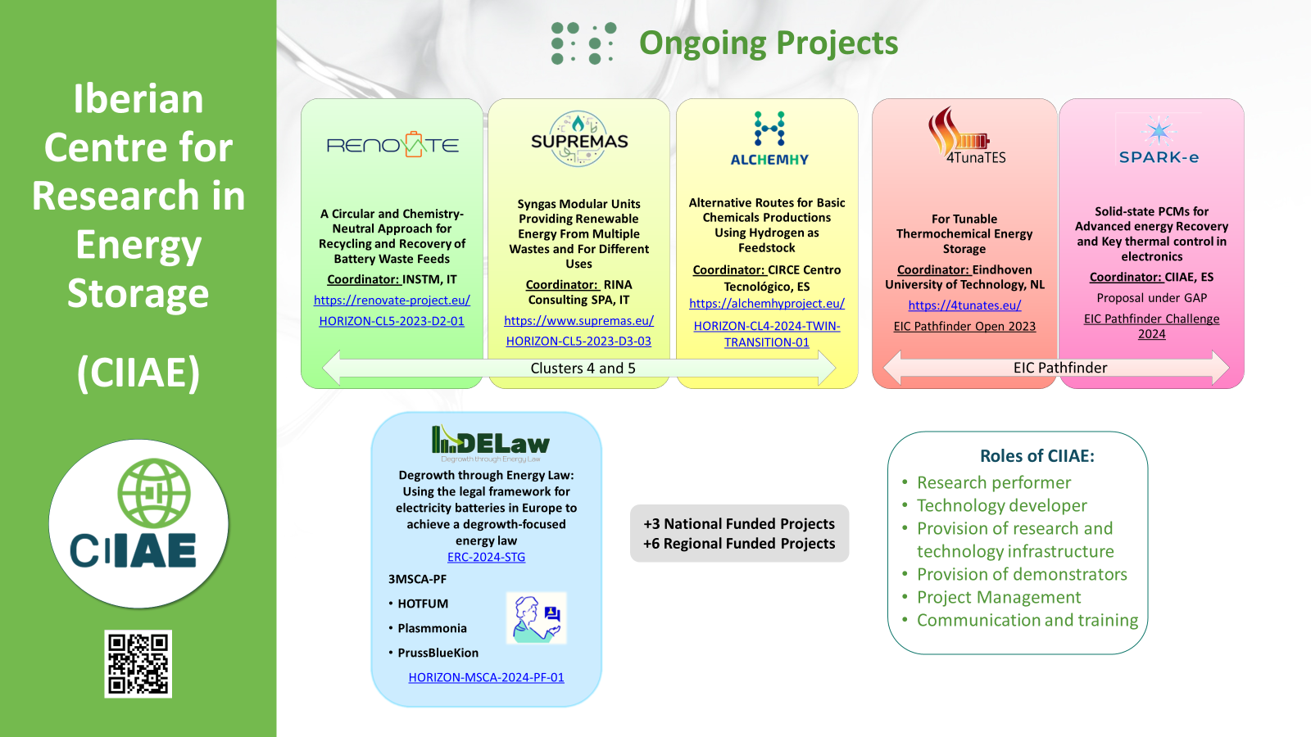

Slide 6
Call - Excellence Hubs HORIZON-WIDERA-2027-04
Opening: 02 Sep 2026
Deadline(s): 04 Mar 2027
Funding per project: 1.50 to 4.50 ME
Nº of projects to be funded: 30
We offer ourselves as the leading institutions abroad.
We offer Fundecyt and its research center CIIAE to create a joint proposal in the field of energy storage with entities in widening countries
We search for R&I ecosystems (umbrella organizations or innovation quadruple helix actors) from Widening countries interested in cooperating in the filed of Energy Storage
We are open to co-lead the proposal with a Widening institution.

Slide 7





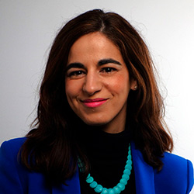
Thank you
FOR YOUR ATTENTION
Follow us in linkedin!
+34 636369896
Cristina.Gallardo@fundecyt-pctex.es
www. Ope-secti.es

